Slide 1


Slide 2
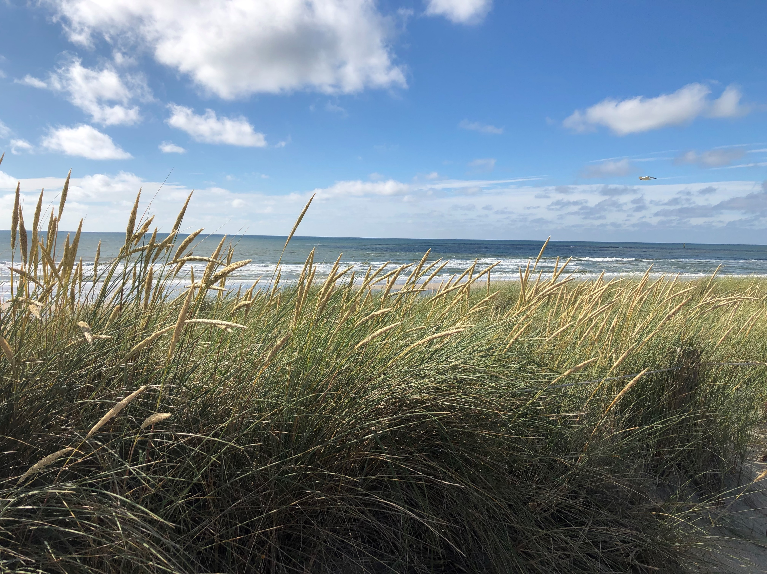

Slide 3


Slide 4




Slide 6



Slide 7



Slide 8


Slide 9
Society / Human
bearable
payable
sustainable
Environment / Nature
Economy / Enterprise
feasible

Slide 10
Gewinn schaffen
Gewinn / Nutzen
Produkte &
Services
Aufgaben
des Kunden
Schmerz lindern
Schmerz
Schlüssel-
partner
Schlüssel-aktivitäten
„Value Proposition“
Kundenbeziehungen
Kunden-
segmente
Schlüssel-ressourcen
Vertriebswege
Kostenstruktur
Umsatzstrom
Strategie

Slide 11

Create Gain
Gain / Benefit
Entry Produkt/ Business
-> usually no/low revenue and profit
Products &
Services
Tasks
of customer or user
Sweet Spot
Relieve Pain
Pain
Legally acquired data about customers/users, their tasks and processes, about pain points and gain points
Data of Partner
Generation of knowledge through analysis and combining of data
Key activities and competencies (e.g. Deep Learning)
Additional externally legally acquired data
Turnover: Sale of knowledge
Gain / Benefit
Final Business: Knowledge driven Business
-> high profit, exponential revenue
Tasks
of customer 2
Pain

Slide 12
Create Gain
Gain / Benefit
Tasks
of customer or user
Entry Produkt/ Business
-> usually no/low revenue and profit
Products &
Services
Sweet Spot
Relieve Pain
Pain
Legally acquired data about customers/users, their tasks and processes, about pain points and gain points
Data of Partner
Generation of knowledge through analysis and combining of data
Key activities and competencies (e.g. Deep Learning)
Additional externally legally acquired data
Turnover: Sale of knowledge
Gain / Benefit
Final Business: Knowledge driven Business
-> high profit, exponential revenue
Tasks
of customer 2
Pain

Slide 13
1. Preparation
Agree on scope, schedule, roles and organization
Review previous activities
Determine starting point
2
2. Determination
Define the goals of the improvement activity
Determine approach
plan User Experience (UX) activities
3
3. Understanding
understanding contexts of use
Create / update landscape
Record interfaces of the processes
Analyze users and stakeholders
Observe processes
4. Analysis
Apply tools for analysis
Record the current state
Prepare and present results
test and collect feedback
synthesize insights
5. Design
6
Design target state
Plan target processes
Determine measurements and visualization / documentation
4
6. Implementation
generate and realize ideas
Determine necessary measures
Implement measures
Test in pilot applications
7. Roll out
Enable all associates
Stabilize new processes and work organization
5

Slide 14
Guideline
A distinction of coaching – consulting - mentoring
solution-oriented
coaching
consulting
person-oriented
task-oriented
mentoring
conflict-oriented
See: Drath, Karsten: Coaching und seine Wurzeln: Erfolgreiche Interventionen und ihre Ursprünge (2012), p. 20 ff

Slide 15


Slide 16


Slide 17


